Slide 1
HemTools Tutorial

Slide 2
Outline
Software overview
General principles
Examples
ATAC-seq
ChIP-seq
CUT & RUN
CRISPR-seq

Slide 3
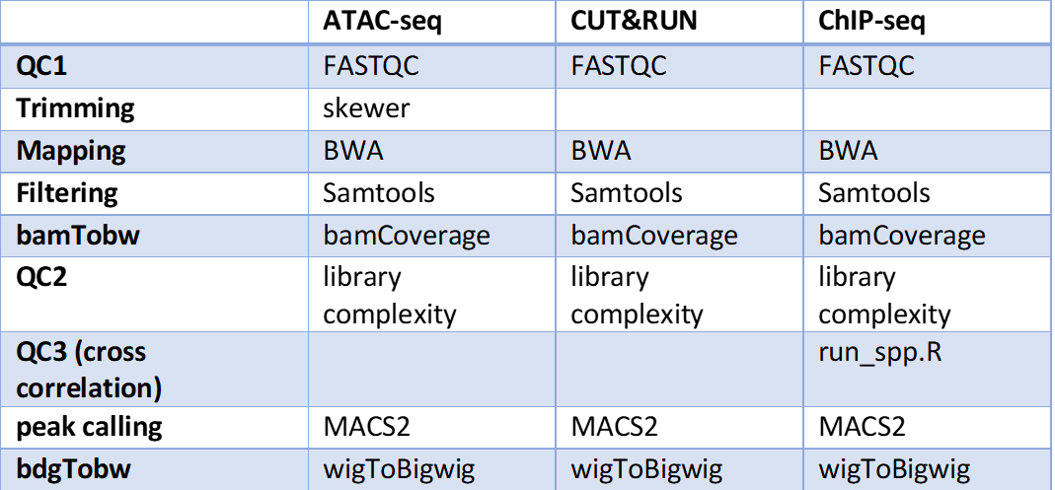
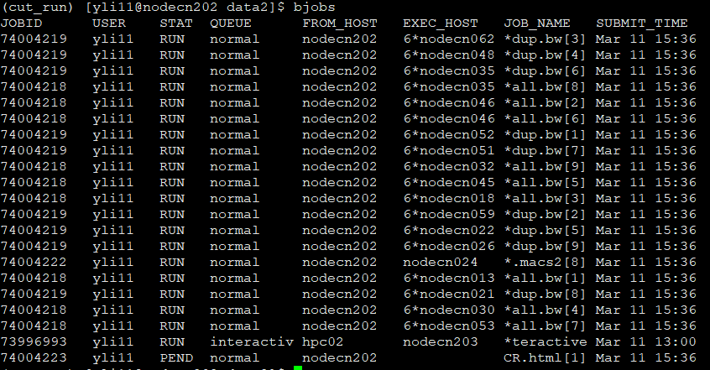
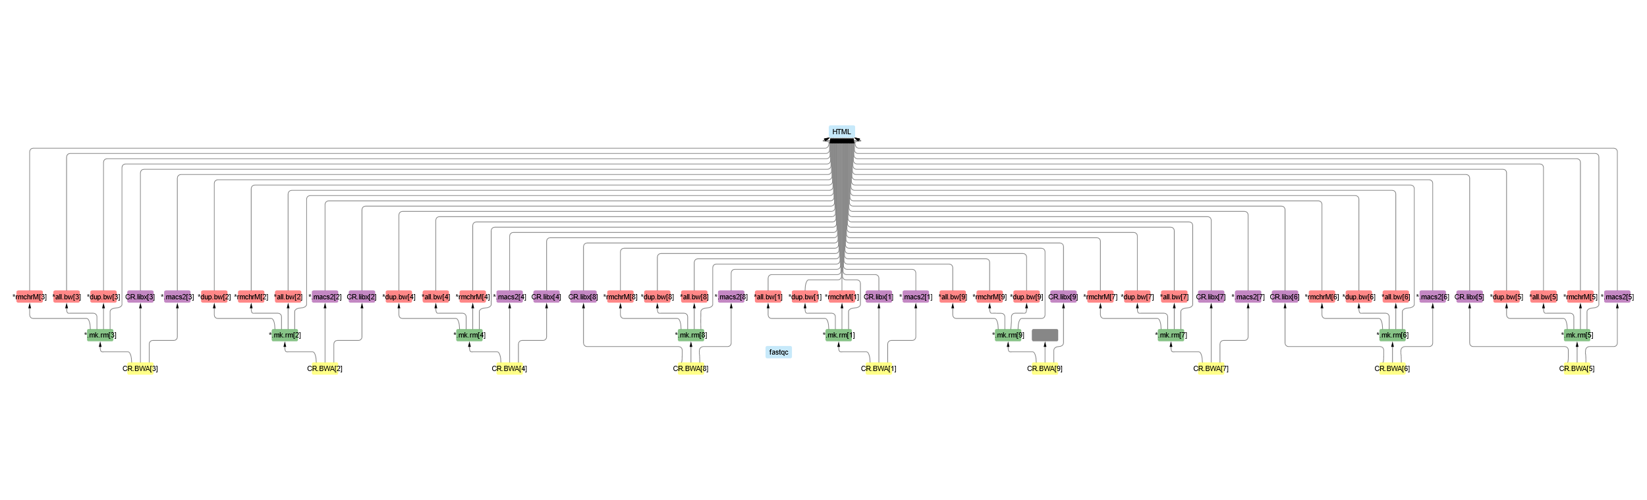
Software overview
Minimizing computation time
A tree of jobs

Slide 4
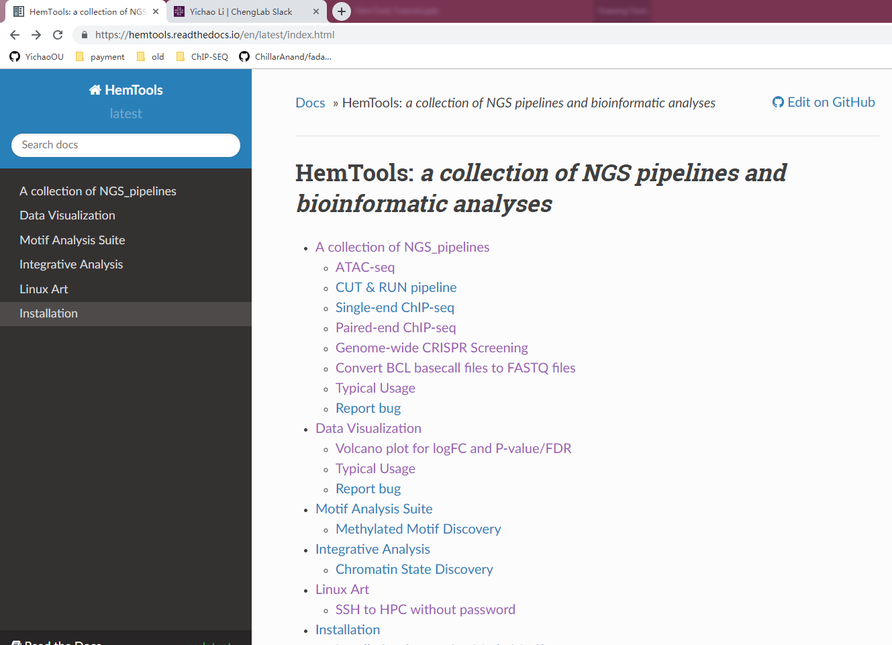
Software overview
Minimizing computation time
A tree of sub-jobs
Creating user-friendly interface
Online documentation
https://hemtools.readthedocs.io

Slide 5
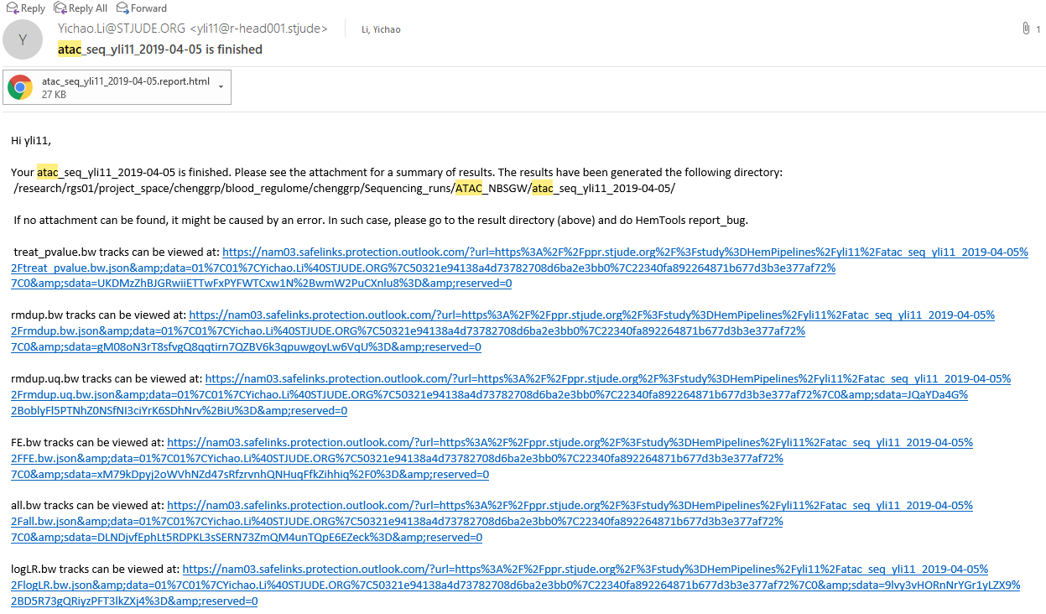
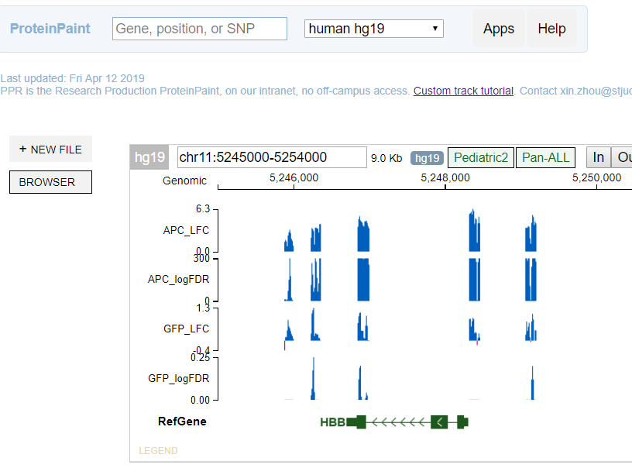
Software overview
Minimizing computation time
A tree of sub-jobs
Creating user-friendly interface
Online documentation
https://hemtools.readthedocs.io
Email notification system

Slide 6
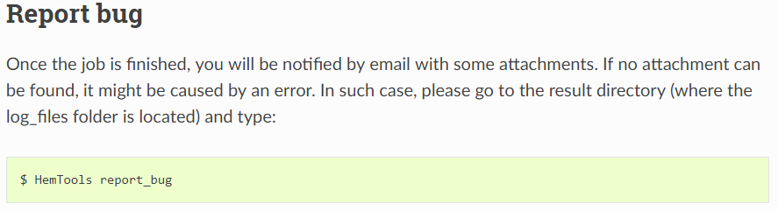
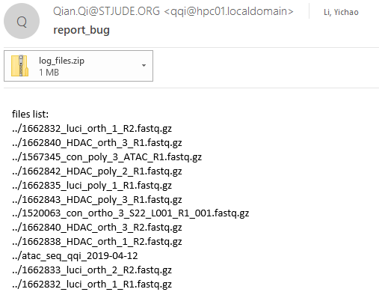
Software overview
Minimizing computation time
A tree of sub-jobs
Creating user-friendly interface
Online documentation
https://hemtools.readthedocs.io
Email notification system
Bug/Error notification system

Slide 7
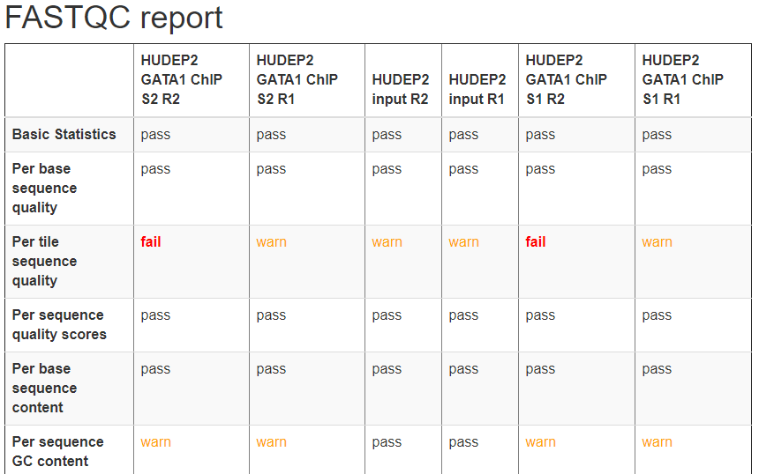
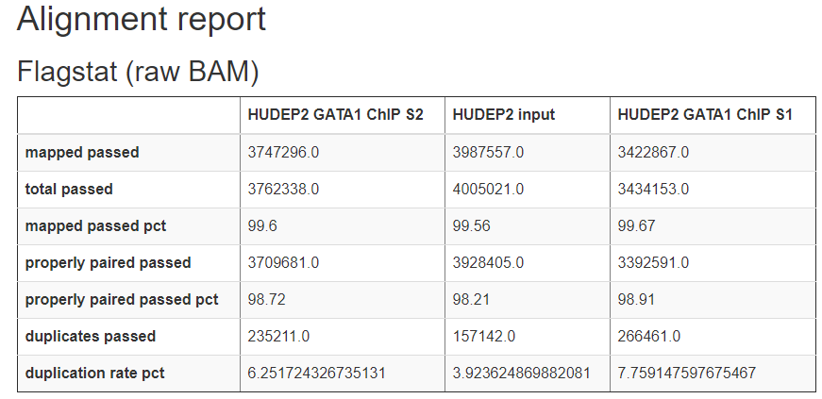
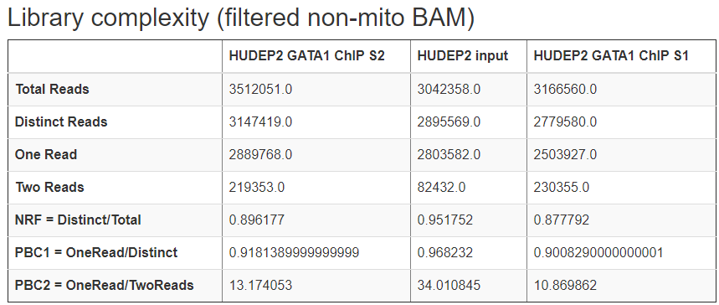
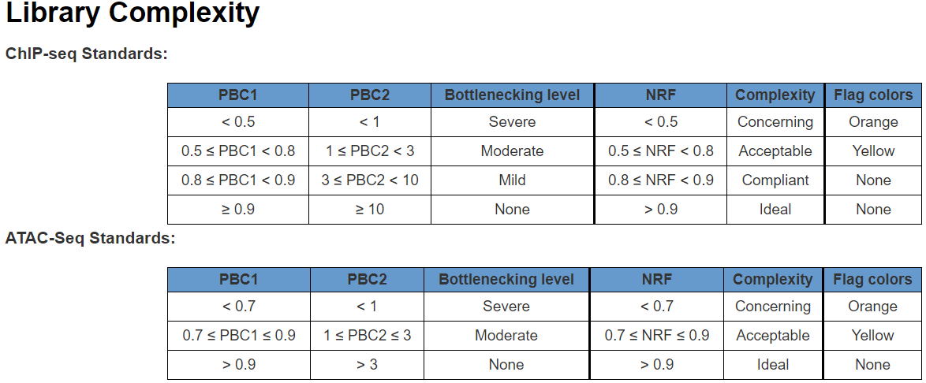
Software overview
Minimizing computation time
A tree of sub-jobs
Creating user-friendly interface
Online documentation
https://hemtools.readthedocs.io
Email notification system
Bug/Error notification system
Visually-appealing reports
https://www.encodeproject.org/data-standards/terms/#library

Slide 8
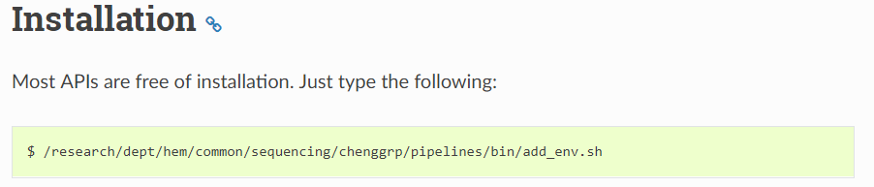
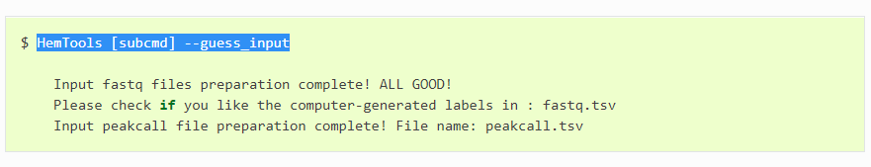
Software overview
Minimizing computation time
A tree of sub-jobs
Creating user-friendly interface
Online documentation
https://hemtools.readthedocs.io
Email notification system
Bug/Error notification system
Visually-appealing reports
Reducing user’s mental effort
Free of installation
Simple input files preparation

Slide 9
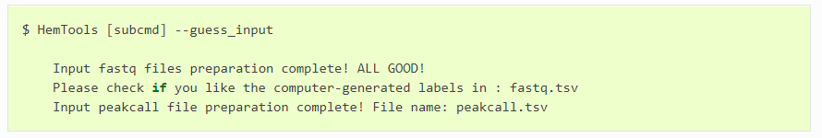
General principles
Workflow
Load Python
Prepare Inputs
Run HemTools

Slide 10
General principles
Command format
HemTools subcmd some_required_parameters
HemTools atac_seq -f fastq.tsv
HemTools cut_run -f fastq.tsv -d peakcall.tsv
HemTools chip_seq_single -f fastq.tsv -d peakcall.tsv
HemTools chip_seq_pair -f fastq.tsv -d peakcall.tsv
subcmd is case-insensitive

Slide 11
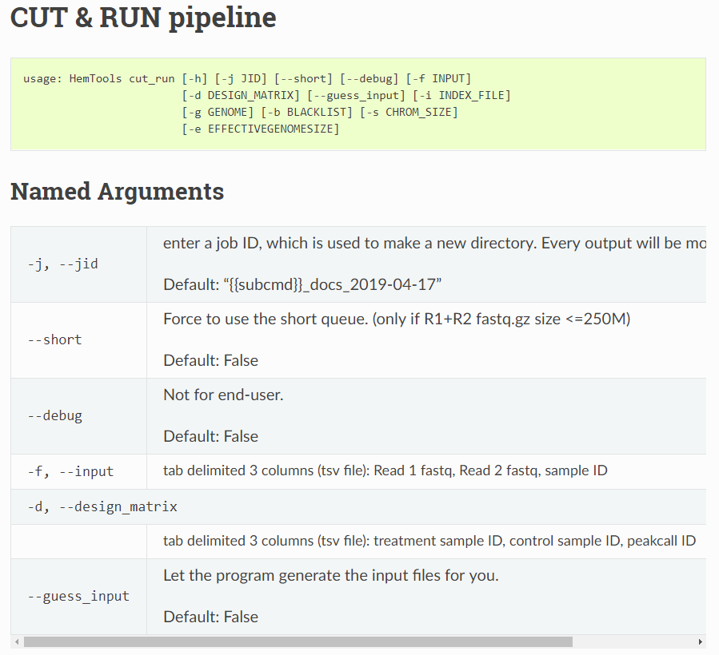
General principles
Required parameters
HemTools atac_seq -f fastq.tsv
HemTools cut_run -f fastq.tsv -d peakcall.tsv
HemTools chip_seq_single -f fastq.tsv -d peakcall.tsv
HemTools chip_seq_pair -f fastq.tsv -d peakcall.tsv

Slide 12
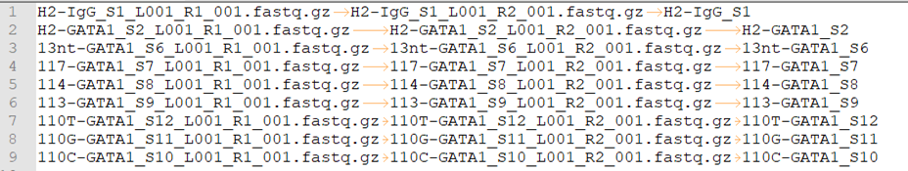
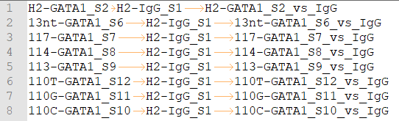
General principles
Command format
HemTools atac_seq -f fastq.tsv
HemTools cut_run -f fastq.tsv -d peakcall.tsv
HemTools chip_seq_single -f fastq.tsv -d peakcall.tsv
HemTools chip_seq_pair -f fastq.tsv -d peakcall.tsv
Input format (tsv, tab-separated values)
-f, --input
-d, --design_matrix

Slide 13
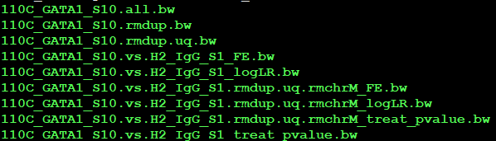
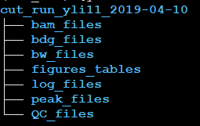
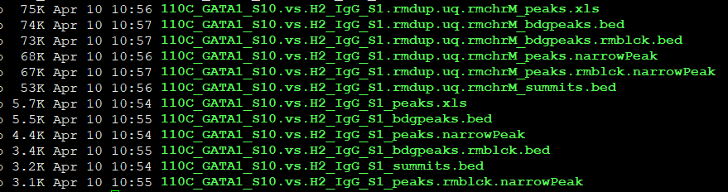
General principles
Output format
Paired-end data will run MACS2 twice:
rmdup.uq bam
raw bam
Single-end data will just run MACS2 using raw bam

Slide 14
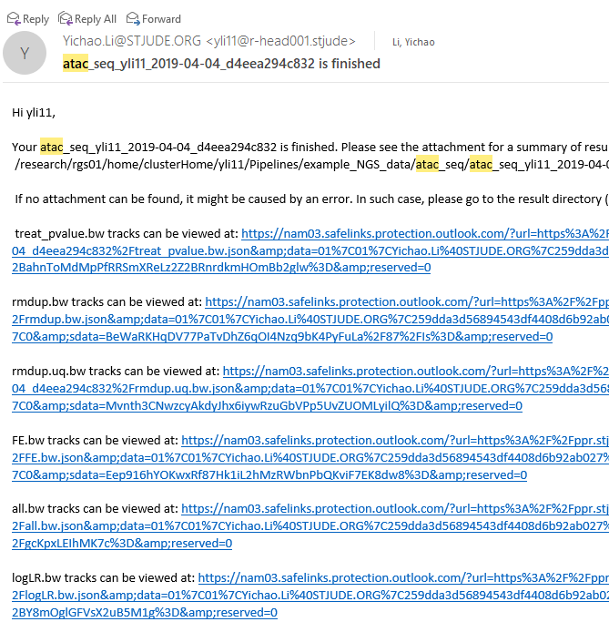
General principles
Report bugs
If no attachment can be found, it might be caused by an error. In such case, please go to the result directory (above) and do HemTools report_bug.
No Attachments!

Slide 15
ATAC-seq example

Slide 16
CUT & RUN example

Slide 17
Materials
Handouts
Questionnaire
Online doc
Terminal
Ppt

Slide 18
Software requirements analysis
Adapting and automating previous pipelines
Minimizing computation time
Creating user-friendly interface
Online end-user documentation
Email notification system
Bug/Error notification system
Visually-appealing reports
Reducing user’s mental effort
Free of installation & ready to use
Simple input files preparation
Easy search for appropriate APIs

Slide 19
Linux 101

